Slide 1

Coffee Maker
Syed Zulfiqar Ali FA20-EEE-059
SYED HASNAT ALI FA20-EEE-058

Slide 2
Outline
Introduction
Literature Review
Methodology
Results
Teamwork
Timeline
Societal Impact
Environmental Impact
Learning
Conclusion

Slide 3
Introduction
Brief introduction to the CEP
Beverages like tea and coffee have become a part of a daily routine of people around the world.
A coffee maker is described as a plug in appliance that pushes hot water through coffee beans to create coffee.
A coffee maker is composed of a heating plate on the bottom, a glass pitcher to catch the coffee in, a water reserve tank, a cup of to hold coffee grounds, and a tube to tie this all together. The water from the reserve tank flows through the heating plate, boils, and then is sent up the tube to wash down through the beans. After it has seeped through the beans, it goes into the glass pitcher which holds it until the user is ready to use it.

Slide 4
Applications
Coffee make is implemented on different places like
Universities
Colleges
Hospitals
Hotels
Small scale industries
Coffee vending machines are placed on road side as many people run their business using these coffee machines.

Slide 5
Objectives
The objective of the project is to design and develop a mini tea and coffee making machine, which dispenses the beverage of required quality in less time. The machine uses readily available tea and coffee premix powder to prepare the beverage. The machine offers options like:
Cappuccino
Espresso
Mild Tea/Coffee
Sugar free Tea/Coffee

Slide 6

Literature Review
A coffee machines is the one that automatically makes a tasty coffee following a complete process. It consist of different chambers that are divided for quantity of powder, sugar, hot water and milk.
The appliance consists of a container made of plastic in which tea or coffee premix powder is placed according to the requirement of the user. The appliance consists of a reservoir for storing water, this reservoir is connected to the heater.
The machines works on the base of programming for every chamber time is set that water valve will on for a few seconds and powder chamber will be open for few seconds. We have to just place the cup and enjoy your coffee.

Slide 7
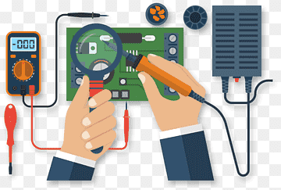
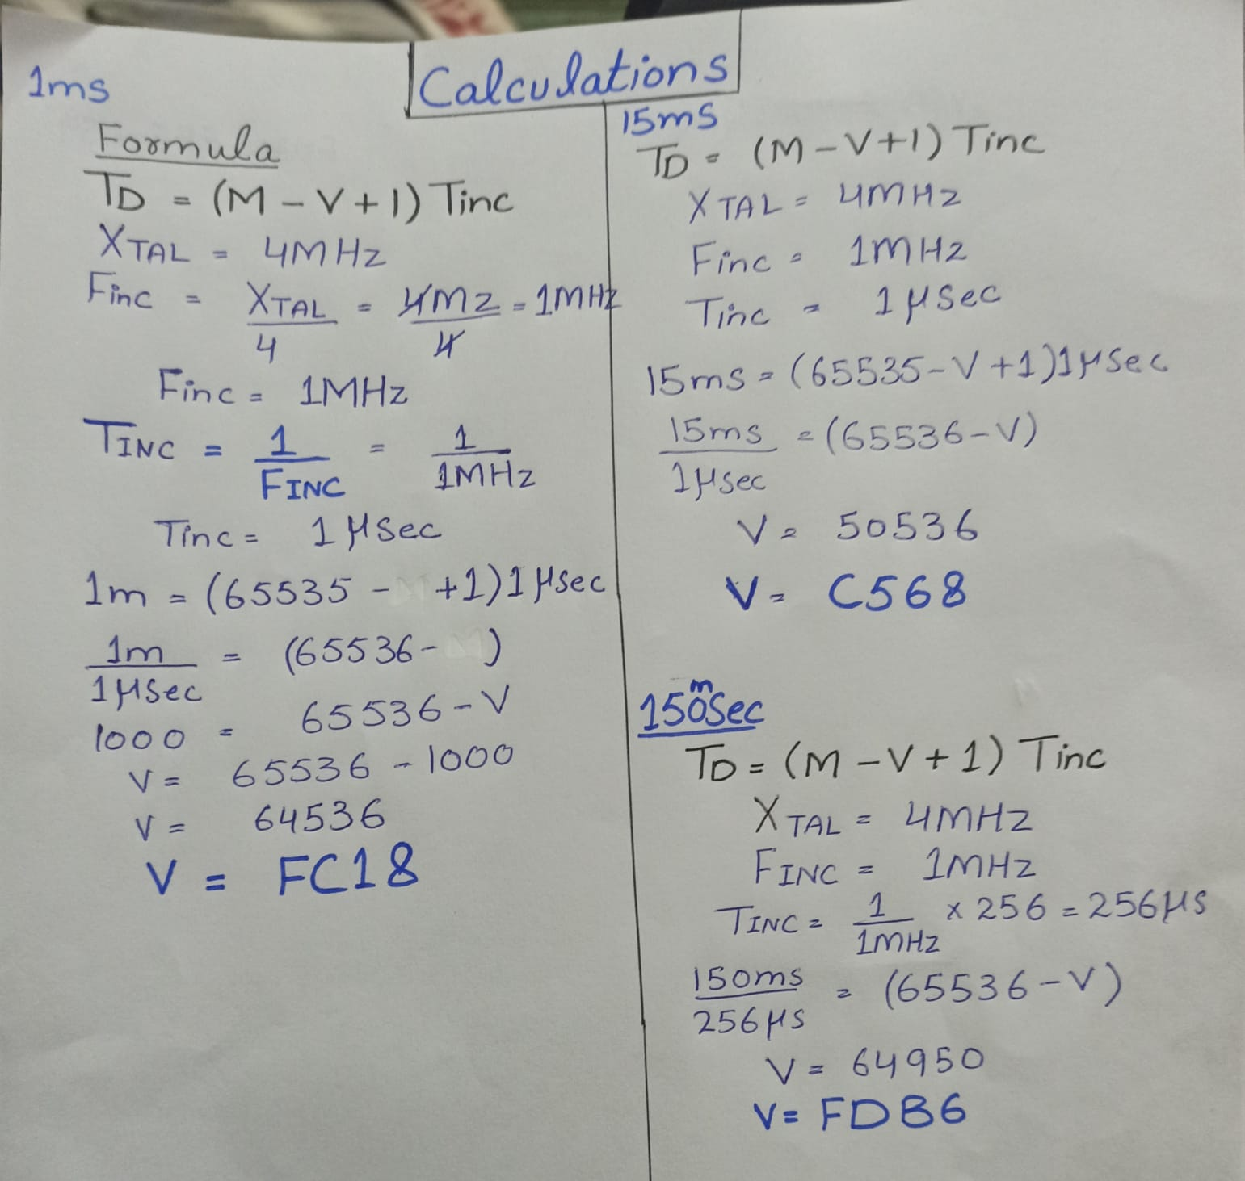
Methodology
Mathematical model

Slide 8
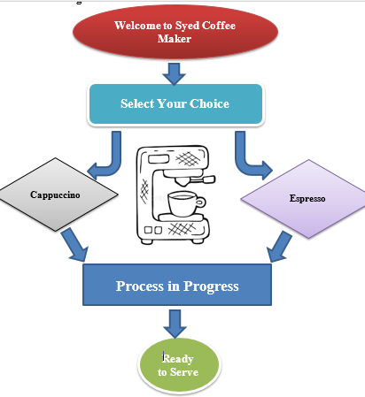
Flow Chart

Slide 9
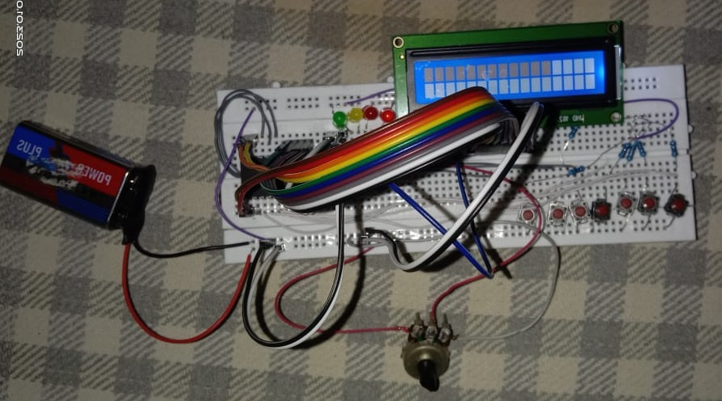
Hardware model

Slide 10
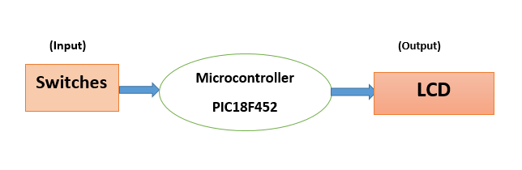
Block Diagram

Slide 11
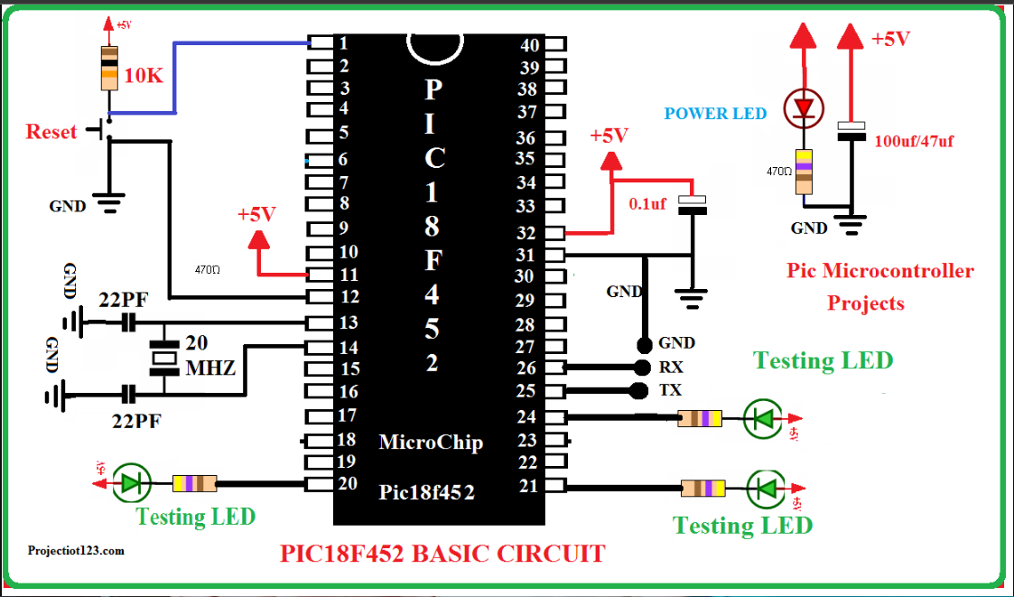
Circuit diagram

Slide 12

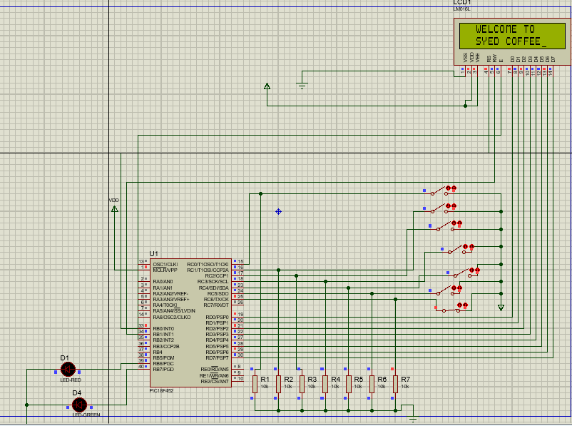
Result
Simulation

Slide 13
Result
Discussion
This project can be enhanced with many features like different options can be added in coffee maker. We can add multiple flavours that can attract customers. Project can be launched in the proper way as a proper vending coffee machine as a business. A great homework is required to build the vending coffee machine in practical like better controllers can be selected with multiple options and with our programming logic we can add multiple features in this project

Slide 14

Team Work
The Whole project was equally distributed among all the group members. First we go through of proper research about the project
First, we draw a block diagram for the project according to selected project then we started to make our project code
We simulate the project using proteus.
Calculated the concern mathematical calculations .
After Simulation we Implemented the main part of the project on Hardware.
Then we made CEP project report and presentation according to given pattern .

Slide 15

Timeline

Slide 16
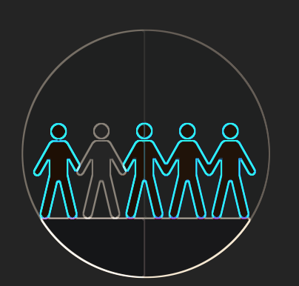
Social Impact
Benefits of Coffee Maker
Portable
Choice of multiple flavours of coffee are available in one machine
Reduces human effort or Labour cost if you setup your business using this machine.
Requires less time to serve many persons at a time.
Drawbacks of Coffee Maker
Expensive
Difficult to maintain
Taste Variations

Slide 17

Environmental Impact
This project is Environmental Friendly.
It does not cause any type of Pollution that is Harmful to our Environment.
No Harmful impact on Human Life.
The one factors that can be harmful is that after drinking the coffee from coffee machine people use to throw cups publically that causes pollution in environment but its responsibility of individual person that we should fulfill our responsibility to save our environment.

Slide 18

Learning
We have learned a lot of thing from this project like:
Team Work
How to fulfill your responsibility
How to deal the pressure to complete the task on time
Time Management
How to build Logic and its practical implementation.
How to design a project model
We learn how to code in microcontroller and how to implement it practically. We learnt about the burning process of microcontroller.

Slide 19
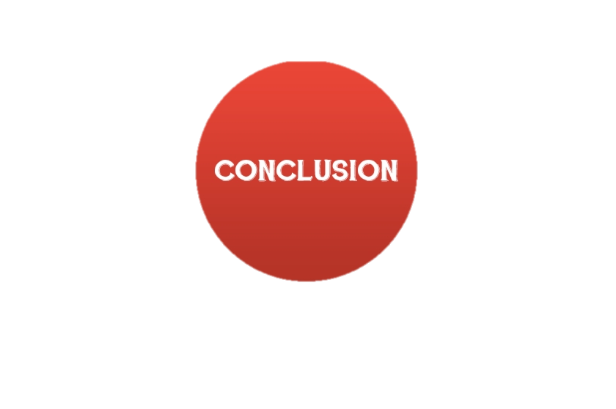
Conclusion
In this project, we have designed and developed a mini tea and coffee making machine that is software based which is capable of dispensing the required quality (taste) of beverage in less time.
Two flavours are currently available in this coffee machine.
We can add multiple options in this project like multiple flavours off coffee can be add with Tea as well and can be practically implemented as coffee vending machine as our business.

